Slide 1


Slide 2


AIMS OF THIS
SESSION
Provide an overview of the test
Discuss test details
Give examples of test items
Discuss effective test taking strategies / tips

Slide 3
SPEAKING
CRITERIA
C | Can produce clear, smoothly flowing well-structured speech with an effective logical structure which helps the recipient to notice and remember significant points.
B2 | Can give clear, systematically developed descriptions and presentations on a wide range of subjects related to his/her field of interest, with appropriate highlighting of significant points, and relevant supporting detail.
B1 | Can reasonably fluently sustain a straightforward description of one of a variety of subjects within his/her field of interest, presenting it as a linear sequence of points.
A2 | Can give a simple description or presentation of people, living or working conditions, daily routines likes/dislikes, etc. as a short series of simple phrases and sentences linked into a list.
A1 | Can produce simple descriptions on mainly personal topics.
A0 | Not enough language knowledge demonstrated to allow for any meaningful inferences about the candidate’s ability.

Slide 4
GENERAL
INFORMATION
There are 4 parts.
There are 10 questions which must be completed in 12 minutes.
The level of difficulty increases as the test progresses.

Slide 5
Speaking Phrases
Phrases to use when you start speaking
- First of all
- Firstly
- Well, I would like to talk about
- I can’t remember much about that, but
- I’ve never really thought about that before, but I would think
- The first thing I would like to say is
- I’m going to talk about
- Let me start by saying
- Initially, I think that
- Well, in terms of
- Actually, in regard to

Slide 6
Speaking Phrases
Phrases to use in the middle of your answer
- Can I add that….?
- I forgot to mention that
- The other thing I should/would say/add is that
- Let me give you an example
Phrases to use when you are nearly finished speaking
Use the words in your question to finish your answer:
- I don’t think I have anything else to add
- I think I’ve covered everything
- That’s about all I can say about that
- Finally/Lastly

Slide 7
Speaking Phrases
Phrases to use to buy time
- That’s a difficult question
- Where shall I start?
- Let me see/think
- That’s a very interesting question
- I’ve never really thought about that before
- Well, let’s see
- Hmm, let me think about that for a moment
- That’s a good question
- That’s quite an interesting question, and I’m definitely not an expert on the topic, but I guess my personal opinion on that would be

Slide 8
Speaking Phrases
Introducing your answer:
- Actually/Well/I guess
- Generally/In general/Mostly/Usually
Speaking about preferences:
- I prefer A to B
- I don’t really like/I don’t particularly enjoy/ I’m not very fond of
- I love/I despise/I hate/I can’t stand
Frequency of events/activities:
- I often (action/activity)
- But sometimes/however I usually
- From time to time/Now and again
- I rarely/occasionally/hardly ever/don’t usually

Slide 9
Speaking Phrases
Future plans:
- I hope to
- It is my dream to
- My ultimate goal is
- I’m thinking of/about
- I’m planning to
- I have a plan to
Generalising
- Overall/Generally/In general
Making an evaluation
- I tend to agree that
- I mostly disagree that
- I completely/totally agree
- I am in total agreement with
- I am certain that

Slide 10
Speaking Phrases
Expressing an opinion:
- In my opinion/point of view
- I strongly believe that
- I really think that
- Personally, I think
- I really support the idea of
- I’m totally in favour of
- Some people think/feel/believe that
- I believe that people should
- It’s very important for/that
- It’s a great idea for people to
- I am convinced that
- I am/feel absolutely certain that A is better than B
- I am quite certain about my opinion concerning
- Some people may disagree with my opinion, but
- My own preference is to favour

Slide 11
Speaking Phrases
Expressing an opinion while uncertain:
- Actually, I’m not really sure, as I have never thought about that before
- Well, it depends, as there are many different factors
- I guess it depends really
- It’s really quite hard to say, as/because
- I don’t really have a strong opinion either way
- Well, probably/possibly
- I am not very familiar with this topic/subject, but I think/believe that
- This is just my opinion, but my first thought on this topic is
Speculating
- It’s difficult to say, but
- I’m not entirely sure, but maybe/perhaps
- I’m fairly certain/sure that
- I would expect that
- As far as I know
- As far as I can see
- It seems likely that

Slide 12
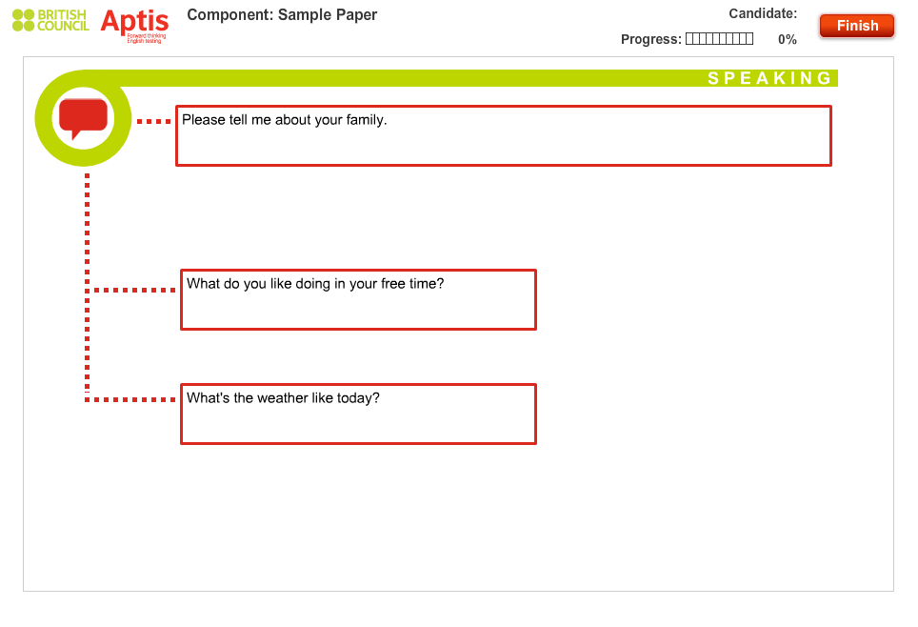
Part 1 –
30 seconds/answer

Slide 13
7 Question Types
1. Basic Description
Tell me about your studies/job.
Tell me about a festival in your country.
Describe what makes you happy.
2. Liking
What food do you like?
What do you like about your hometown?
Do you like shopping?
Do you like sport?

Slide 14
7 Question Types
3. Disliking
Is there anything you don’t like about your studies/work?
Are there any clothes that you don’t like?
What type of weather do you dislike?
4. Types of
What kinds of restaurants are popular in your country?
What hobbies are common in your country?
What types of TV programmes are popular in your country?

Slide 15
7 Question Types
5. Wh-/How often
When you go out in the evenings, what do you usually do?
How often do you play sports?
How often do you eat out in restaurants?
6. Yes/No
Is watching TV a popular activity in your country?
Can you play a musical instrument?
Do you think you are an ambitious person?
7. Would
Would you like to be in a film?
What would you like to change about your city?
What would you like to change about your school/workplace?

Slide 16
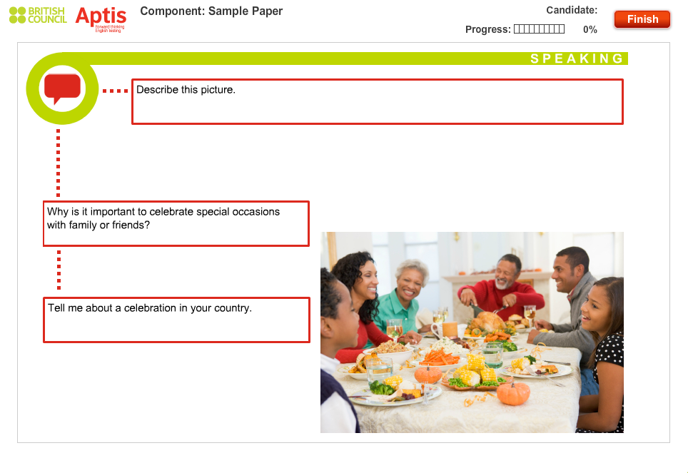
Part 2 –
45 seconds/answer

Slide 17
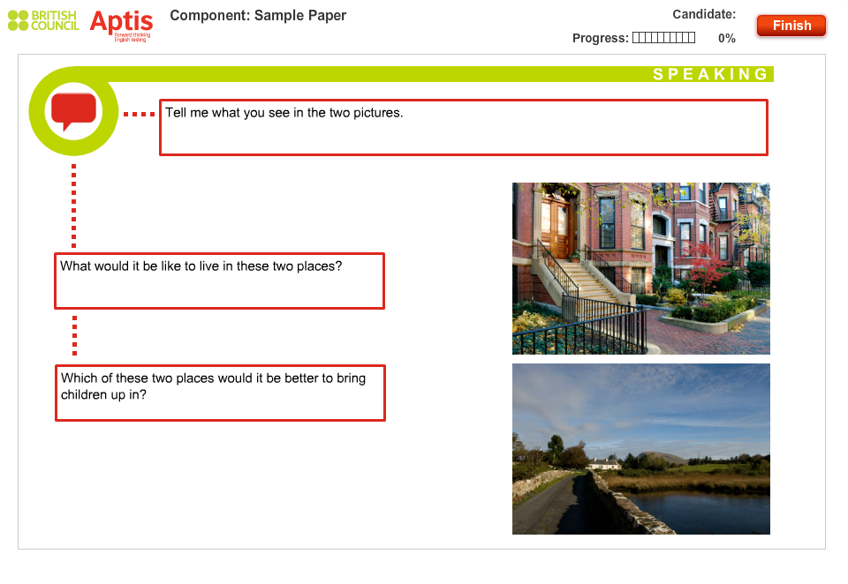
Part 3 –
45 seconds/answer

Slide 18
Part 3
Remember to use
Comparatives “It’s better than…”
Superlatives “It’s the most convenient…”
Conditionals “If I lived there…”
Contrasting connectives “However…”

Slide 19
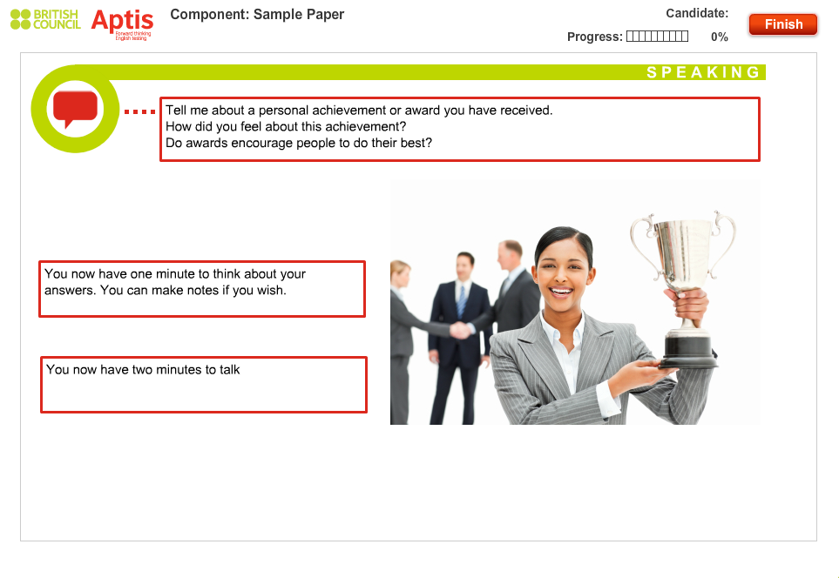
Part 4 –
2 minute answer

Slide 20
Connecting Phrases
- Going to my next point…
- Continuing to my next point…
- Now with regard to the next question…
- Now on the subject of…
- Now concerning the matter of…
- What I’d like to add here is that…
- What I need to emphasize here is that…
- What I ought to stress here is that…
- The thing that needs to be highlighted here is that…
- What I have to mention here is that…
- Proceeding to the issue of…
- Finally then, if there’s time, I could deal with the last question of…

Slide 21
TIPS
Listen carefully to the questions you’re asked so that your answers are relevant.
Answer the questions you’re asked with some detail so that your answers are long enough.
Use the preparation time in Part 4 to think about the questions and take notes.
Use in Part 4 to help you to organize your long turn.
Explain your opinions and give examples to support them.
Don't talk about something different from what’s in the question.
Don’t worry if your answer is longer than 2 minutes in Part 4.
Don’t worry if you can’t think of a word, try to paraphrase and get round it.
Don’t worry if you realize you’ve made a mistake. It’s OK to correct yourself. If you can't correct yourself, forget it and carry on.

